Slide 1
Nested table in HTML

Slide 2
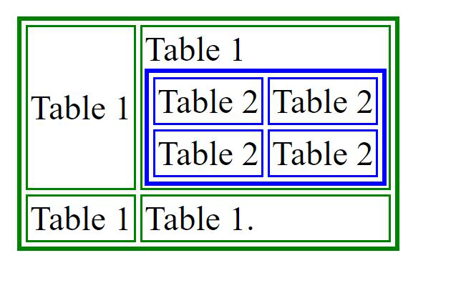
To create a nested table, we need to create a table using the <table> tag. This table is known as the outer table. The second table that will be nested table is called the inner table. This table is also created using the <table> tag but there is a special thing that must be kept in mind.
Note: The inner table always has to be placed between the <td> ….. </td> of the outer table.
<html>
<body>
<table border="2" bordercolor="green">
<tr>
<td>Table 1</td>
<td> Table 1
<table border="2" bordercolor="blue">
<tr>
<td>Table 2</td>
<td>Table 2</td>
</tr>
<tr>
<td> Table 2 </td>
<td>Table 2</td>
</tr>
</table>
</td>
</tr>
<tr>
<td> Table 1 </td>
<td> Table 1. </td>
</tr>
</table>
</body>
</html>

Slide 3
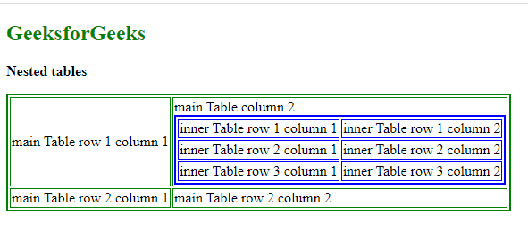
<html>
<body>
<h2 style="color:green">Table Example </h2>
<p><b>Nested tables</b></p>
<table border="2" bordercolor="green">
<tr>
<td>main Table row 1 column 1</td>
<td>main Table column 2
<table border="2" bordercolor="blue">
<tr>
<td>inner Table row 1 column 1</td>
<td>inner Table row 1 column 2</td>
</tr>
<tr>
<td>inner Table row 2 column 1 </td>
<td>inner Table row 2 column 2</td>
</tr>
<tr>
<td>inner Table row 3 column 1 </td>
<td>inner Table row 3 column 2</td>
</tr>
</table>
</td>
</tr>
<tr>
<td> main Table row 2 column 1 </td>
<td> main Table row 2 column 2 </td>
</tr>
</table>
</body>
</html>

Slide 4
HTML Forms
An HTML form is used to collect user input. The user input is most often sent to a server for processing.
The <form> element is a container for different types of input elements, such as: text fields, checkboxes, radio buttons, submit buttons, etc.
The <input> Element
The HTML <input> element is the most used form element.
An <input> element can be displayed in many ways, depending on the type attribute.

Slide 5
The <input> Element
Type | Description
<input type="text"> | Displays a single-line text input field
<input type="radio"> | Displays a radio button (for selecting one of many choices)
<input type="checkbox"> | Displays a checkbox (for selecting zero or more of many choices)
<input type="submit"> | Displays a submit button (for submitting the form)
<input type="button"> | Displays a clickable button

Slide 6
Here are the different input types you can use in HTML:
<input type="button">
<input type="checkbox">
<input type="color">
<input type="date">
<input type="datetime-local">
<input type="email">
<input type="file">
<input type="hidden">
<input type="image">
<input type="month">
<input type="number">
<input type="password">
<input type="radio">
<input type="range">
<input type="reset">
<input type="search">
<input type="submit">
<input type="tel">
<input type="text">
<input type="time">
<input type="url">
<input type="week">

Slide 7
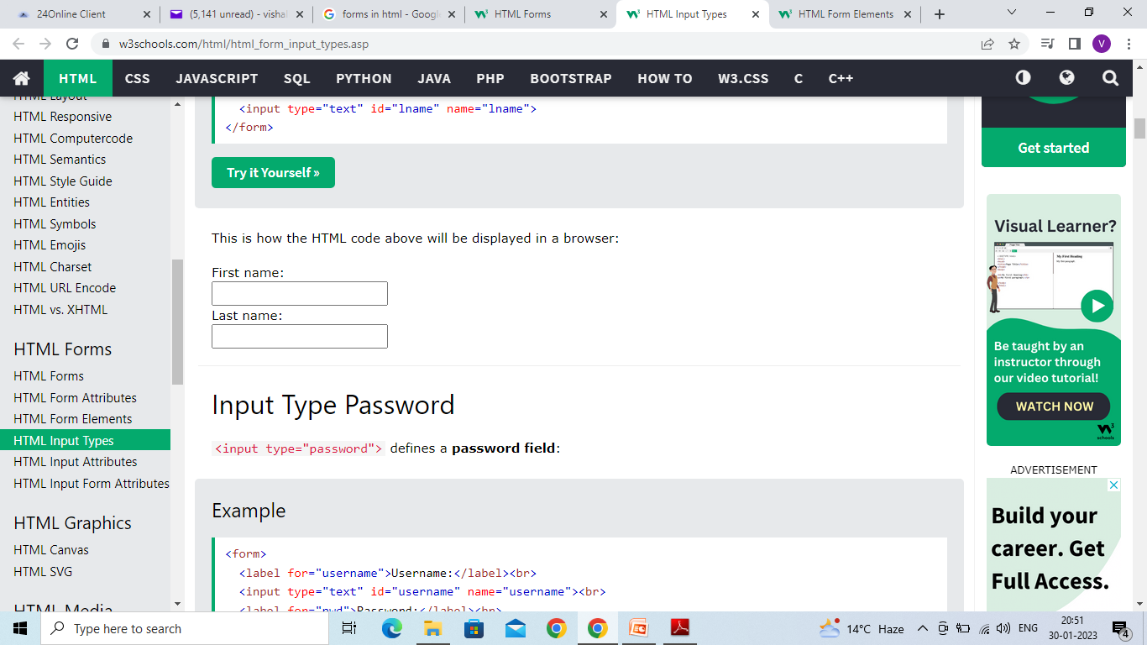
Input Type Text
<input type="text"> defines a single-line text input field:
<form>
<label for="fname">First name:</label><br>
<input type="text" id="fname" name="fname"><br>
<label for="lname">Last name:</label><br>
<input type="text" id="lname" name="lname">
</form>

Slide 8
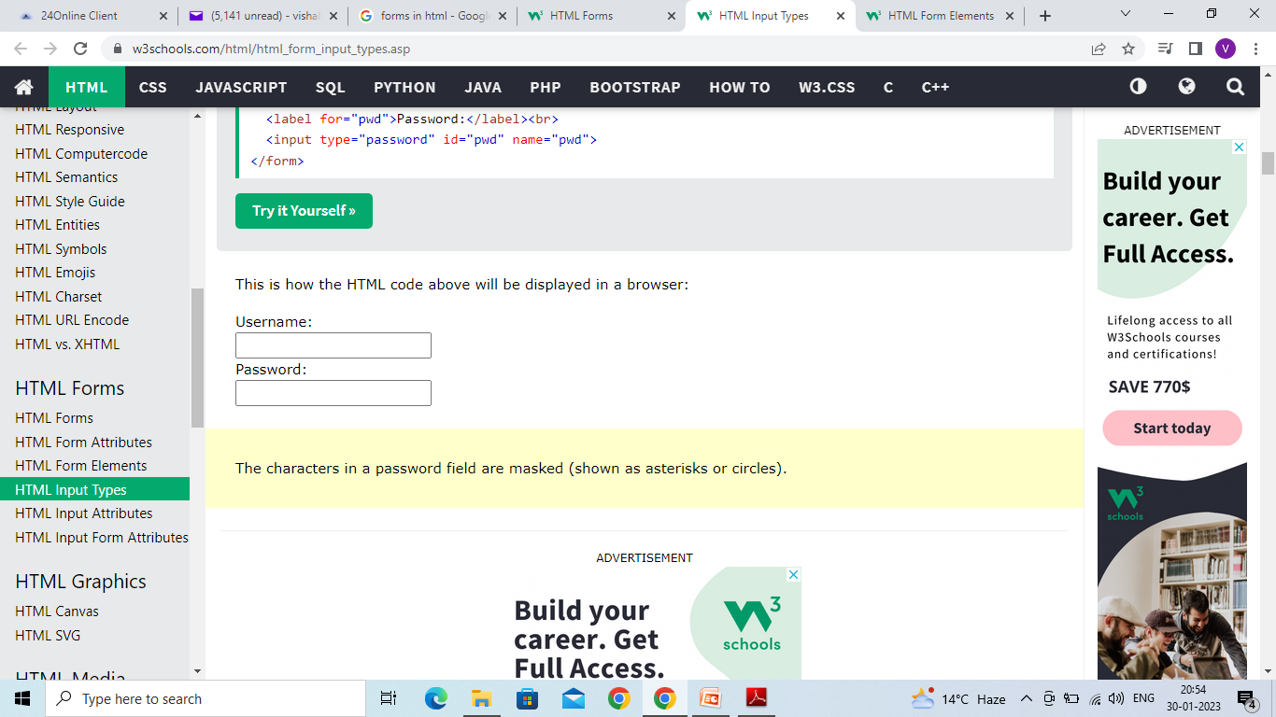
Input Type Password
<input type="password"> defines a password field:
<form>
<label for="username">Username:</label><br>
<input type="text" id="username" name="username"><br>
<label for="pwd">Password:</label><br>
<input type="password" id="pwd" name="pwd">
</form>

Slide 9
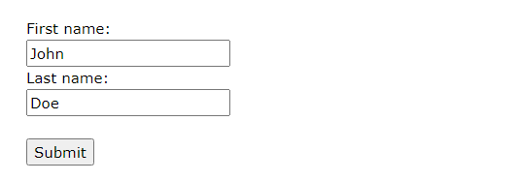
Input Type Submit
<input type="submit"> defines a button for submitting form data to a form-handler.
The form-handler is typically a server page with a script for processing input data.
<form action="/action_page.php">
<label for="fname">First name:</label><br>
<input type="text" id="fname" name="fname" value="John"><br>
<label for="lname">Last name:</label><br>
<input type="text" id="lname" name="lname" value="Doe"><br><br>
<input type="submit" value="Submit">
</form>

Slide 10
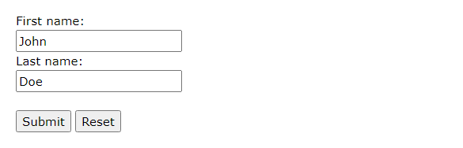
Input Type Reset
<input type="reset"> defines a reset button that will reset all form values to their default values:
<form action="/action_page.php">
<label for="fname">First name:</label><br>
<input type="text" id="fname" name="fname" value="John"><br>
<label for="lname">Last name:</label><br>
<input type="text" id="lname" name="lname" value="Doe"><br><br>
<input type="submit" value="Submit">
<input type="reset">
</form>

Slide 11
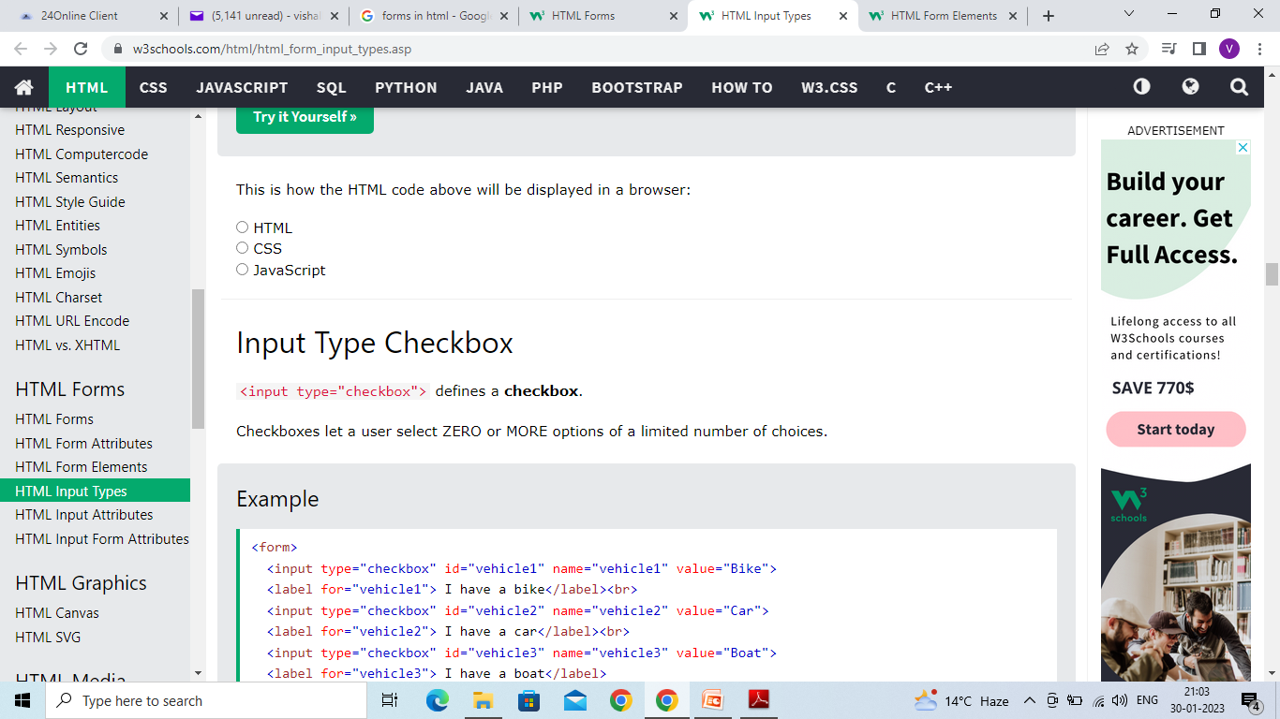
Input Type Radio
<input type="radio"> defines a radio button.
Radio buttons let a user select ONLY ONE of a limited number of choices:
<form>
<input type="radio" id="html" name="fav_language" value="HTML">
<label for="html">HTML</label><br>
<input type="radio" id="css" name="fav_language" value="CSS">
<label for="css">CSS</label><br>
<input type="radio" id="javascript" name="fav_language" value="JavaScript">
<label for="javascript">JavaScript</label>
</form>

Slide 12
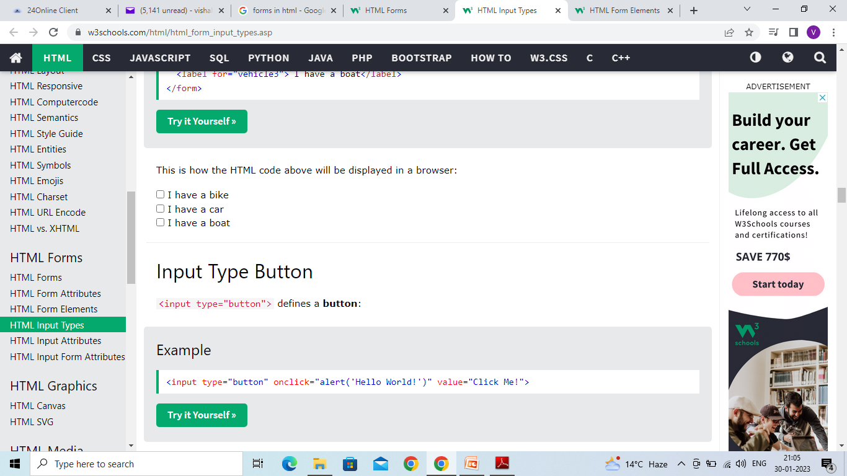
Input Type Checkbox
<input type="checkbox"> defines a checkbox.
Checkboxes let a user select ZERO or MORE options of a limited number of choices.
<form>
<input type="checkbox" id="vehicle1" name="vehicle1" value="Bike">
<label for="vehicle1"> I have a bike</label><br>
<input type="checkbox" id="vehicle2" name="vehicle2" value="Car">
<label for="vehicle2"> I have a car</label><br>
<input type="checkbox" id="vehicle3" name="vehicle3" value="Boat">
<label for="vehicle3"> I have a boat</label>
</form>

Slide 13
Input Type Button
<input type="button"> defines a button:
<input type="button" onclick="alert('Hello World!')" value="Click Me!">
On clicking click me button – Hello World will be displayed on web browser

Slide 14
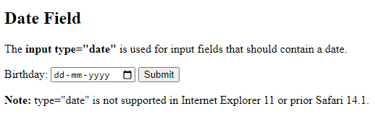
Input Type Date
The <input type="date"> is used for input fields that should contain a date.
Depending on browser support, a date picker can show up in the input field.
<!DOCTYPE html>
<html>
<body>
<h2>Date Field</h2>
<p>The <strong>input type="date"</strong> is used for input fields that should contain a date.</p>
<form action="/action_page.php">
<label for="birthday">Birthday:</label>
<input type="date" id="birthday" name="birthday">
<input type="submit" value="Submit">
</form>
<p><strong>Note:</strong> type="date" is not supported in Internet Explorer 11 or prior Safari 14.1.</p>
</body>
</html>

Slide 15
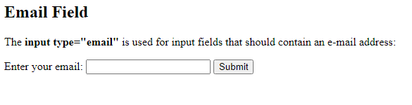
Input Type Email
The <input type="email"> is used for input fields that should contain an e-mail address.
Depending on browser support, the e-mail address can be automatically validated when submitted.
Some smartphones recognize the email type, and add ".com" to the keyboard to match email input.
<!DOCTYPE html>
<html>
<body>
<h2>Email Field</h2>
<p>The <strong>input type="email"</strong> is used for input fields that should contain an e-mail address:</p>
<form action="/action_page.php">
<label for="email">Enter your email:</label>
<input type="email" id="email" name="email">
<input type="submit" value="Submit">
</form>
</body>
</html>

Slide 16
Input Type Image
The <input type="image"> defines an image as a submit button.
The path to the image is specified in the src attribute.
<!DOCTYPE html>
<html>
<body>
<h2>Display an Image as the Submit button</h2>
<form action="/action_page.php">
<label for="fname">First name: </label>
<input type="text" id="fname" name="fname"><br><br>
<label for="lname">Last name: </label>
<input type="text" id="lname" name="lname"><br><br>
<input type="image" src="img_submit.gif" alt="Submit" width="48" height="48">
</form>
<p><b>Note:</b> The input type="image" sends the X and Y coordinates of the click that activated the image button.</p>
</body>
</html>

Slide 17
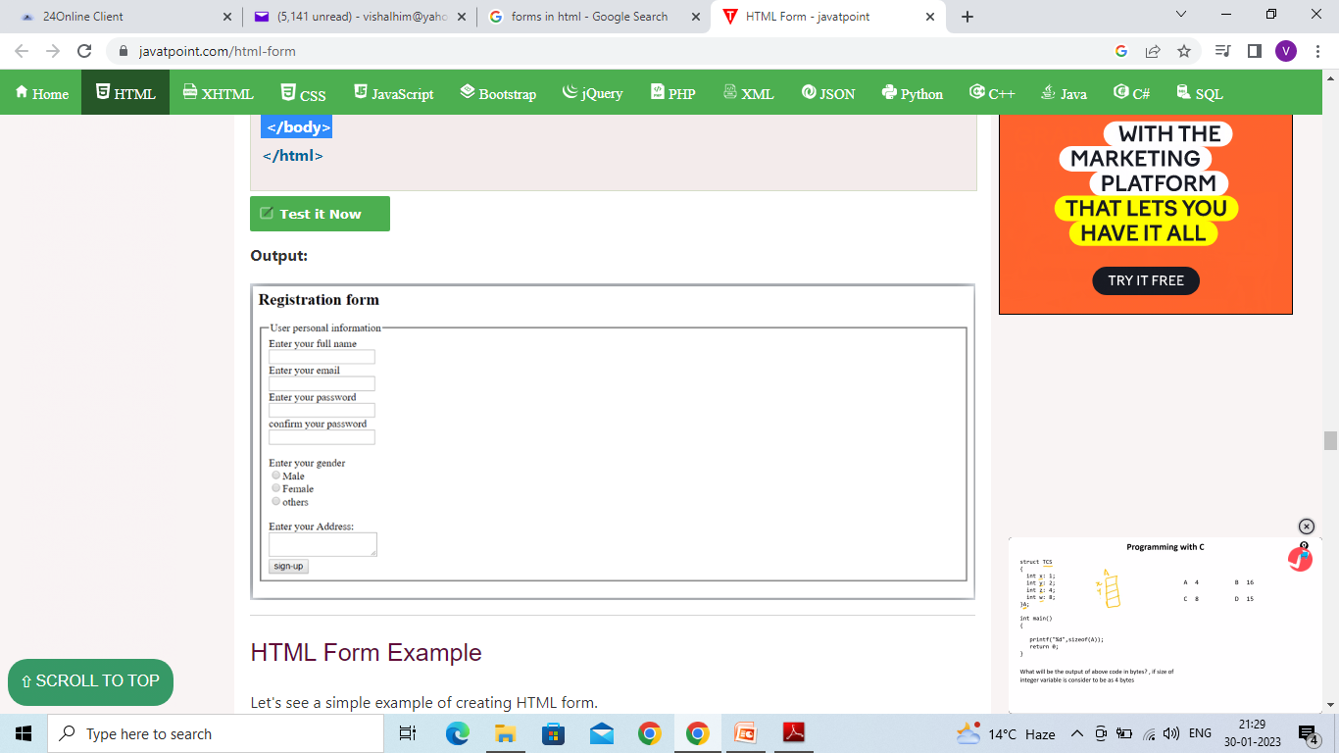
<body>
<h2>Registration form</h2>
<form>
<fieldset>
<legend>User personal information</legend>
<label>Enter your full name</label><br>
<input type="text" name="name"><br>
<label>Enter your email</label><br>
<input type="email" name="email"><br>
<label>Enter your password</label><br>
<input type="password" name="pass"><br>
<label>confirm your password</label><br>
<input type="password" name="pass"><br>
<br><label>Enter your gender</label><br>
<input type="radio" id="gender" name="gender" value="male"/>Male <br>
<input type="radio" id="gender" name="gender" value="female"/>Female <br/>
<input type="radio" id="gender" name="gender" value="others"/>others <br/>
<br>Enter your Address:<br>
<textarea></textarea><br>
<input type="submit" value="sign-up">
</fieldset>
</form>
</body>
The <fieldset> tag is used to group related elements in a form. The <fieldset> tag draws a box around the related elements.

